Slide 1
Iterator Design Pattern
SE450 Winter 2020 (online)
Ximan Liu and Ying Kam Chiu

Slide 2
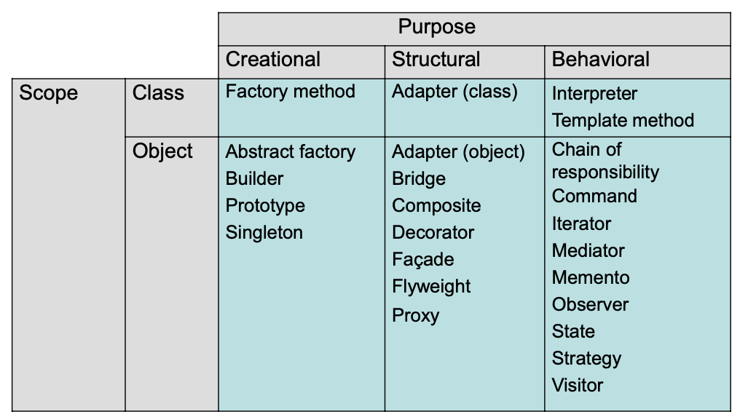
Design Patterns in GoF: The Big Picture
Behavioral
Notes:
Ying

Slide 3
Iterator Pattern - Intent
Provides a way to access the elements of an aggregate object sequentially without exposing its underlying representation
Allows a client to access contents of a center data structure without knowing about the internal representation of the contents
Notes:
Ying

Slide 4
Iterator Pattern - Applicability
You want to support multiple simultaneous traversals of a collection
You want to provide a uniform interface for traversing different collections
Notes:
Ying

Slide 5
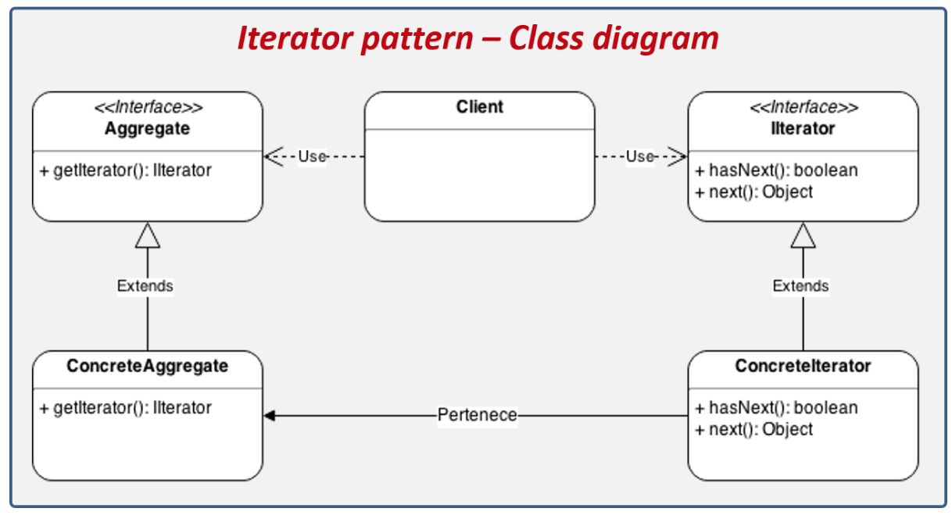
Iterator Pattern - UML Class Diagram
Notes:
Ying

Slide 6
Iterator Pattern - Participants
Iterator - defines an interface for accessing the elements and traversing the elements
Concrete Iterator - implements the Iterator interface and keeps track of the current position in the traversal of the aggregate
Aggregate - defines an interface for creating an Iterator object
Concrete Aggregate - implements the Iterator creation interface to return an instance of the proper Concrete Iterator
Notes:
Ying

Slide 7
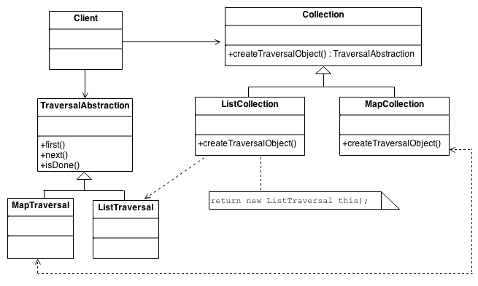

Iterator Pattern - Structure
The Client uses the Collection class' public interface directly. But access to the Collection's elements is encapsulated behind the additional level of abstraction called Iterator. Each Collection derived class knows which Iterator derived class to create and return. After that, the Client relies on the interface defined in the Iterator base class.
Notes:
Ximan

Slide 8
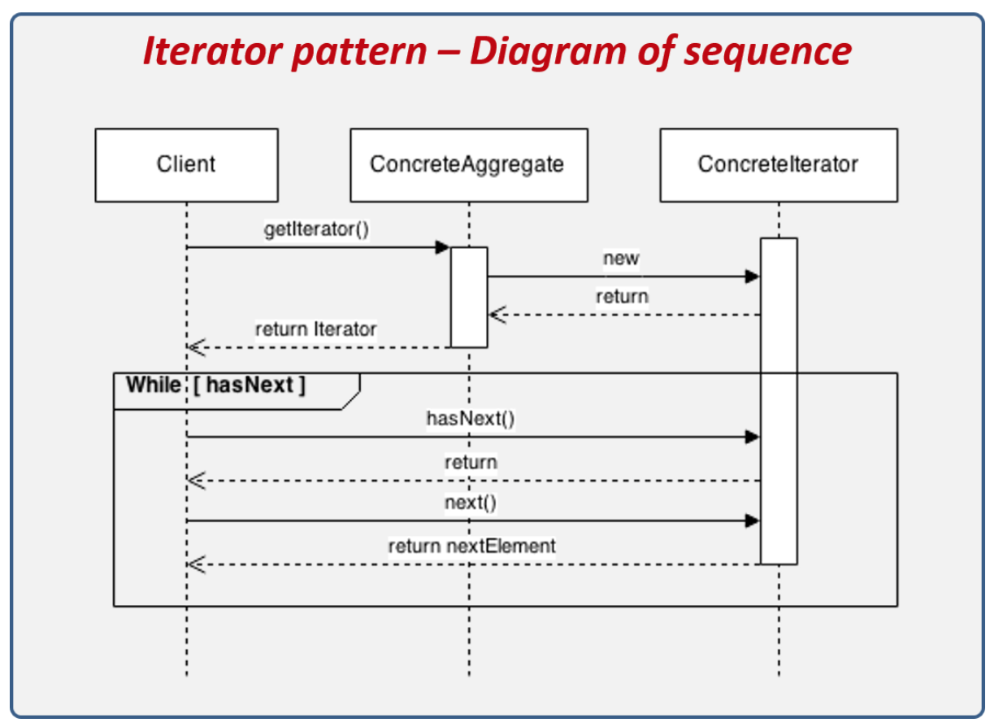
Iterator Pattern - Sequence Diagram
Notes:
Ximan

Slide 9
Iterator Pattern
- Sequence Consequences
Iterator Pattern supports variations in the traversal of an aggregate. Every time you want to change the traversal algorithm, you just replace the iterator instance with a different one.
Iterators simplify the Aggregate interface.
More than one traversal can be pending on an aggregate. An iterator keeps track of its own traversal state. Therefore you can have more than one traversal in progress at once.
Notes:
Ximan

Slide 10
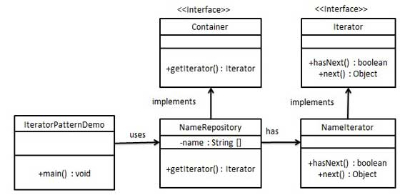
Iterator Pattern - Example (1)
Create a Iterator interface which narrates navigation method and a Container interface which returns the iterator . Concrete classes implementing the Container interface will be responsible to implement Iterator interface and use it.
IteratorPatternDemo, our demo class will use NamesRepository, a concrete class implementation to print a Names stored as a collection in NamesRepository.
Notes:
Ximan

Slide 11
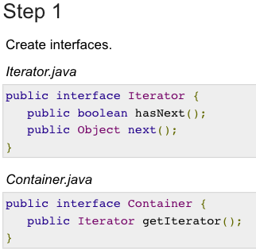
Iterator Pattern - Example (1)
JAVA codes
Notes:
Ximan

Slide 12
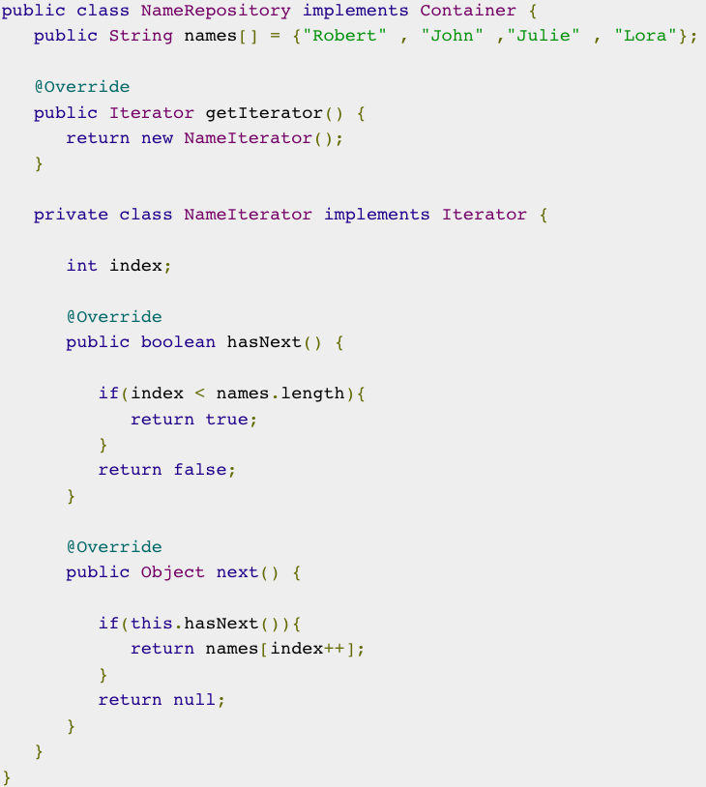
Iterator Pattern - Example (1)
JAVA codes
Step 2
Create concrete class implementing the Container interface. This class has inner class NameIterator implementing the Iterator interface.
NameRepository.java
Notes:
Ximan

Slide 13
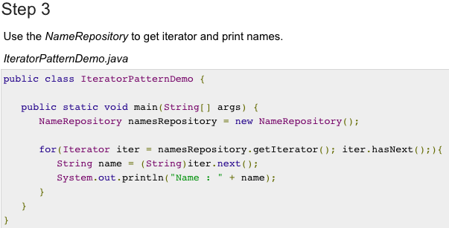
Iterator Pattern - Example (1)
JAVA codes
Notes:
Ximan

Slide 14
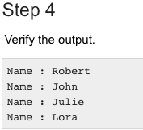
Iterator Pattern - Example (1)
Output
Notes:
Ximan

Slide 15
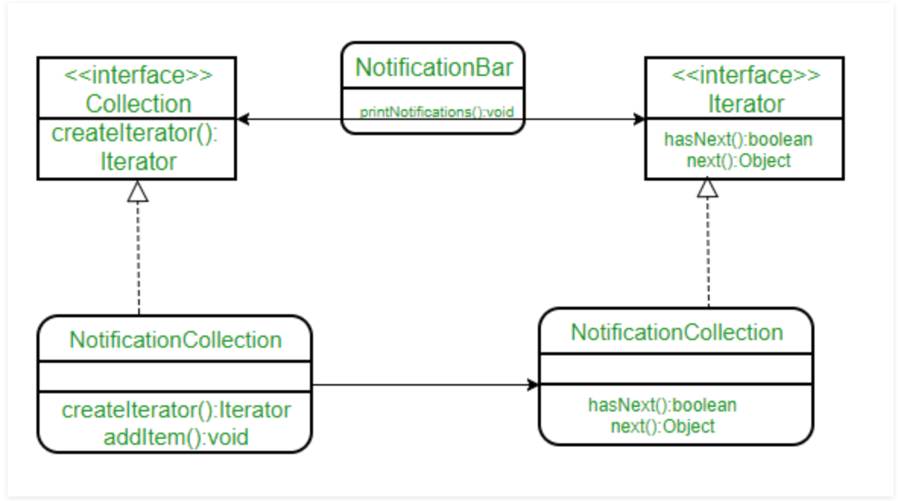
Iterator Pattern: Example (2)
Create a notification bar that displays all the notifications
NotificationCollection provides an iterator to iterate over its elements without exposing how it has implemented the collection (array in this case) to the Client (NotificationBar).
Notes:
Ying

Slide 16
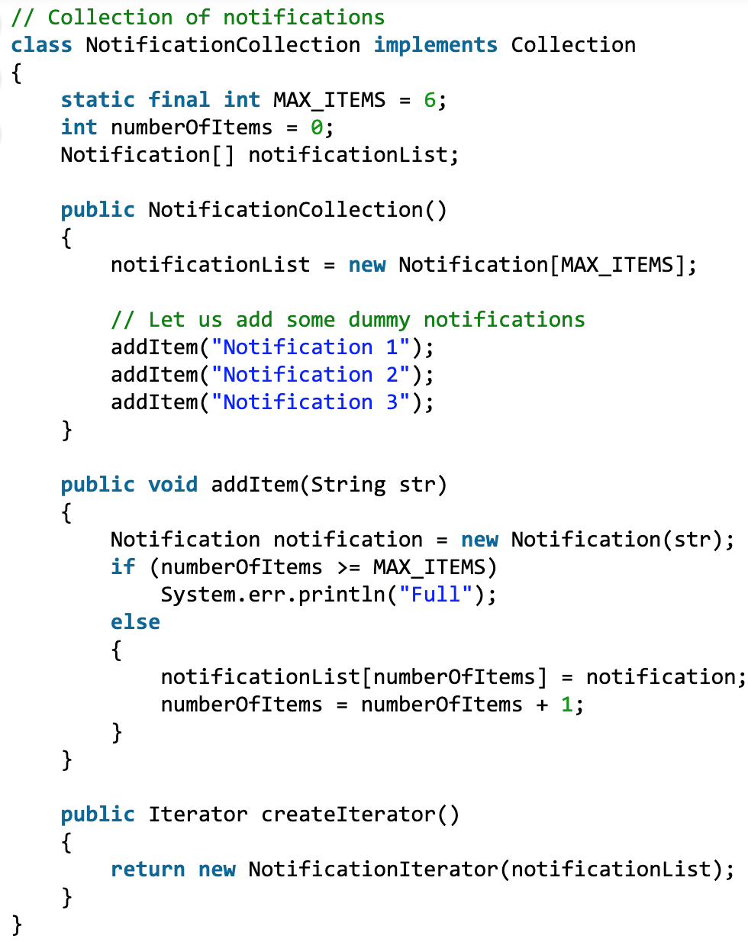
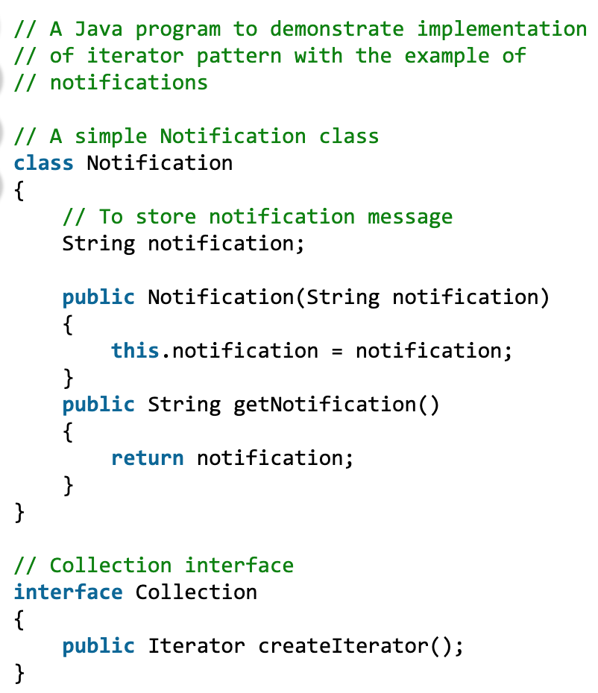
Iterator Pattern: Example (2) JAVA codes
Notes:
Ying

Slide 17
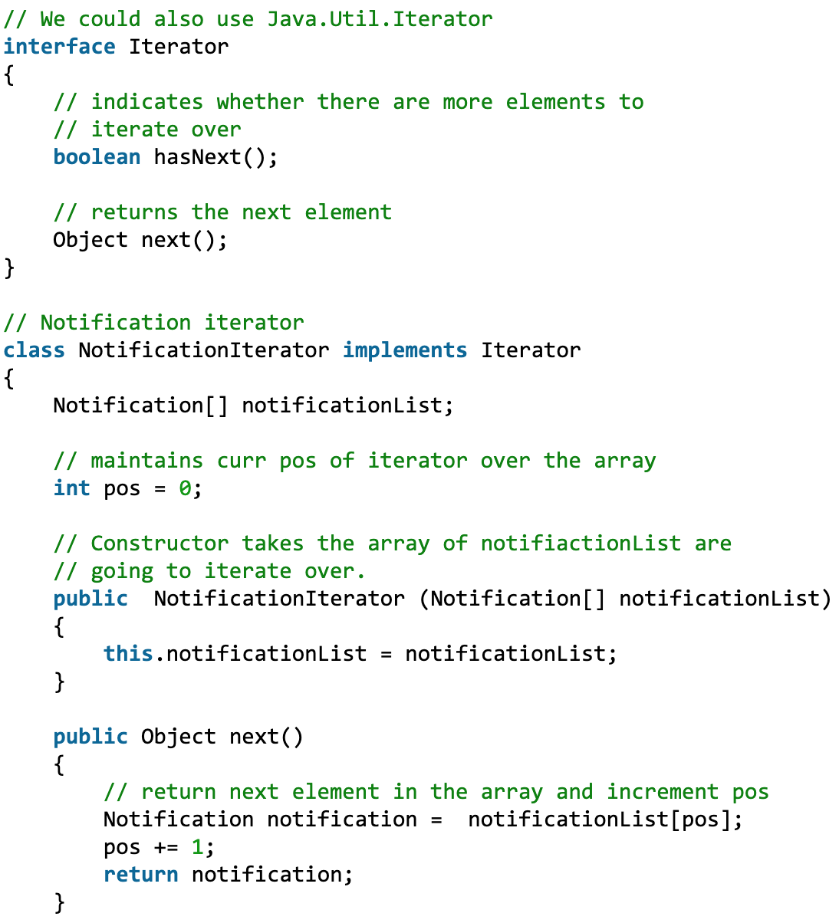
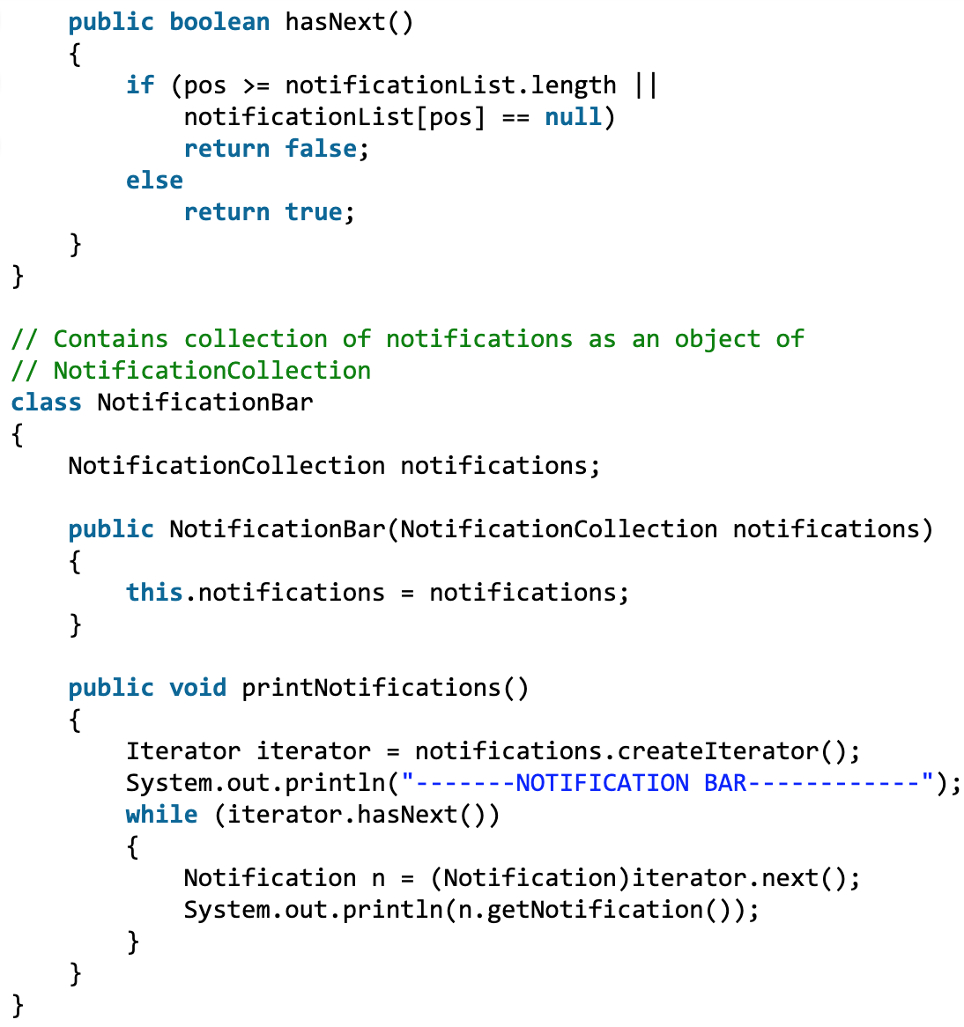
Iterator Pattern: Example (2) JAVA codes
Notes:
Ying

Slide 18
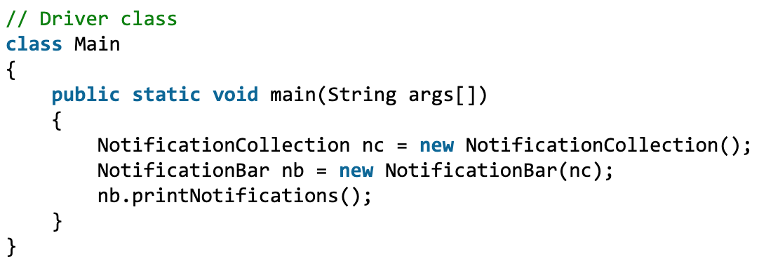
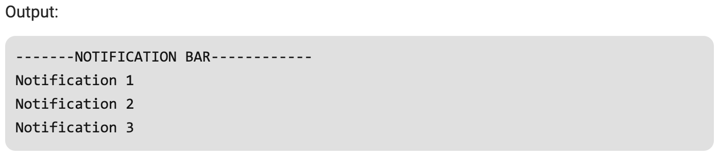
Iterator Pattern: Example (2) JAVA codes
Notes:
Ying

